Slide 1

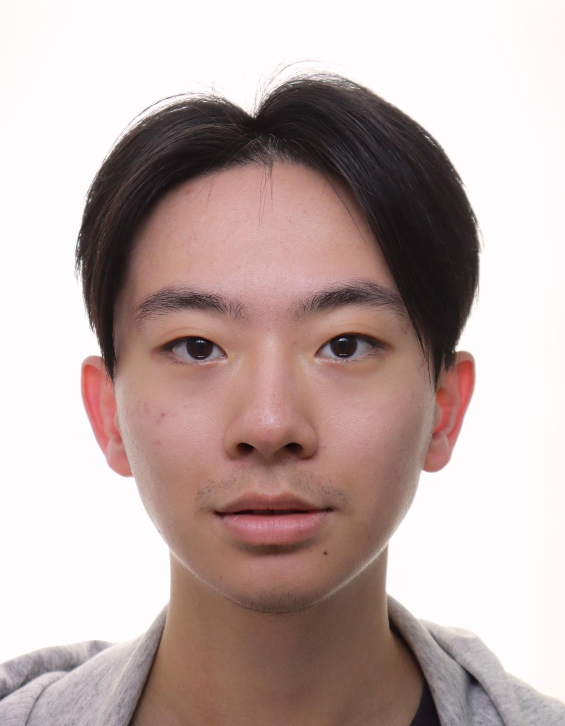

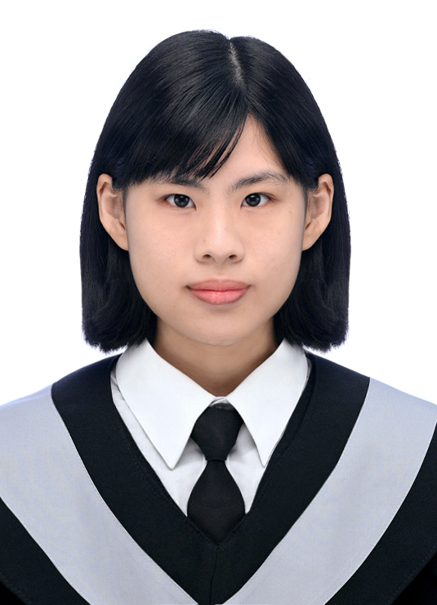

Large Language Model and AI Agent System for Smart City:
A Systematic Literature Review
Institute of Information Management, National Taipei University
Hsin-Ting Lu
Xu-You Lan
Bor-Jen Chen
Min-Yuh Day*
* myday@gm.ntpu.edu.tw
The 29th workshop on Information Management & Practice (IMP2024), Taipei, Taiwan, November 21, 2024

Slide 2
Outline
I
Introduction
II
Literature Review
III
Methodology
IV
Result and Analysis
V
Conclusion

Slide 3
I. Introduction
Large Language Model and AI Agent System for Smart City

Slide 4
Research Background
The Challenges of Smart City
The role of Large Language Models
Smart cities aim to enhance urban efficiency and quality of life using advanced technologies. (Chen, 2012)
Traffic is a growing problem as cities expand.
Large Language Models (LLMs) have emerged as transformative technologies, offering robust language processing and multimodal capabilities (Touvron et al., 2023; Xu et al., 2024).
LLM-based AI agents are increasingly applied to solve complex urban challenges, particularly in traffic systems (Zhang et al., 2024b).
Transportation systems are critical, requiring innovative solutions for real-time management and decision-making.

Slide 5
Research Motivation
Gap in Research
Limited studies explore the integration of LLMs into smart city transportation (Xu et al., 2023a)
Significance
Understanding how LLM-based agents contribute to traffic management can address key urban challenges like congestion, safety, and efficiency (de Zarzà et al., 2023).

Slide 6
Research Objective
Research question:
How do LLM-based agent systems contribute to the development and management of smart cities?
Conduct a systematic review to:
Examine applications of LLM-based AI agents in smart city traffic systems.
Identify trends, challenges, and opportunities in this domain.
Provide insights for advancing urban traffic management using LLMs.

Slide 7
II. Literature Review
Large Language Model and AI Agent System for Smart City

Slide 8
Literature Review
Research Theme | Key Findings | References
The evolution of LLMs | LLMs are foundational AI technologies with strong capabilities in language understanding and multimodality. | Huang & Chang (2022); Touvron et al. (2023)
Framework of LLM-based AI agents | LLM agents operate using Profile, Memory, Planning, and Action modules for dynamic interactions. | Wang et al. (2024b)
Multimodal applications of LLMs | Combining text, image, and audio modalities enhances task execution efficiency and flexibility. | Xu et al. (2024)
Integration in smart cities | Initial studies indicate LLM potential in traffic management, data prediction, and simulation. | Zhang et al. (2024a)

Slide 9
III. Methodology
Large Language Model and AI Agent System for Smart City

Slide 10
Research Method
Preferred Reporting Items for Systematic Reviews and Meta-Analyses (PRISMA)(Page et al., 2021)
Inclusion Criteria:
1. Related to smart cities based on large language models.
2. Focusing on traffic-related topics.
3. The articles must be published in English.
4. The publication date should range from 2022 to August 2024.
5. The articles must be accessible.
Exclusion Criteria:
1. Articles not published in English
2. Articles that do not provide a detailed description of large language models
3. Studies where the application domain is unclear or irrelevant
4. Articles that are not accessible

Slide 11
Data Collection
Academic Database
Web of Science
Query String
Set | Query String | Results
S1 | ALL=(Agent OR AI Agent OR Artificial Intelligence Agent OR Intelligent Agent OR AI System OR Virtual Agent) AND ALL = (large language model OR llm-based OR Generative Model OR Language Generation Model) | 6532
S2 | [S1] AND (TS=(Traffic OR Circulation OR accident)) | 184
Table 1. Keyword Strategies and Results via Web of Science Database

Slide 12
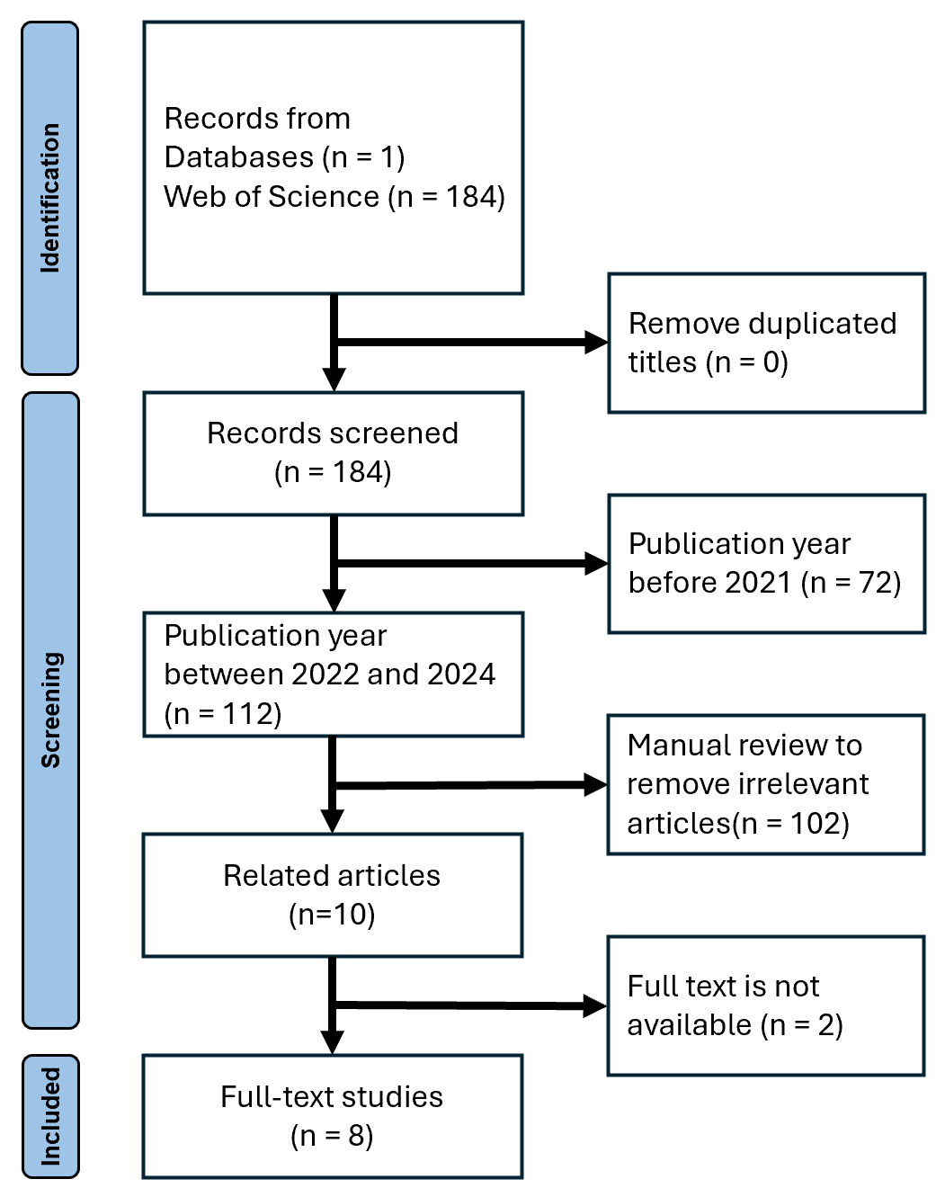
Screening Process
Figure 1. Flow chart for screening and selection of articles.

Slide 13
IV. Result and Analysis
Large Language Model and AI Agent System for Smart City

Slide 14
Trend Analysis
Figure 2. Growing trend analysis of AI and Smart City Traffic Management using Web of Science (2014-2024)

Slide 15
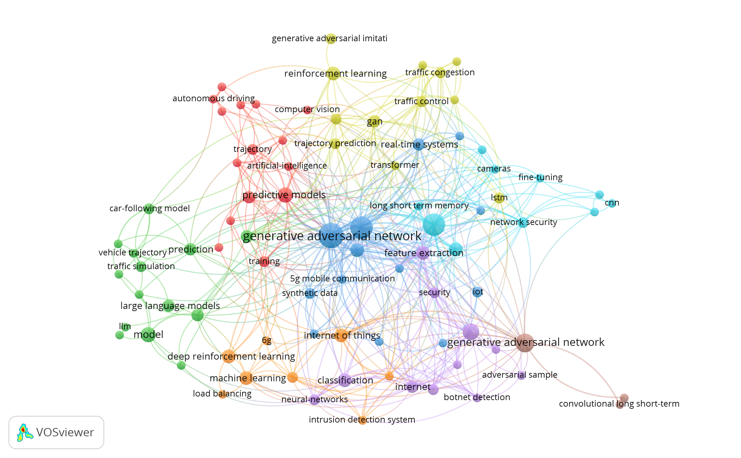
Keyword Co-occurrence Networks
Figure 3. Keyword Co-Occurrence networks of AI and Smart City Traffic Management Literature (2022-2024)

Slide 16
Publisher Type Analysis
Publisher Type | Results
IEEE | 43
Elsevier | 16
MDPI | 14
Springer | 11
Association for Computing Machinery (ACM) | 8
Other | 20
Table 2. Publisher Types Based on the Application of AI and Smart City Traffic Management (2022-2024)

Slide 17
Document Types Analysis
Document Type | Results
Journal Article | 70
Conference Proceedings | 42
Table 3. Document Types Based on the Application of AI and Smart City Traffic Management (2022-2024)

Slide 18
Overview of Selected Studies
Study | AI Techniques | Traffic-Related Focus | Challenges
TrafficGPT: Viewing, Processing and Interacting with Traffic Foundation Models (Zhang et al., 2024b) | Large Language Models (LLMs), Traffic Foundation Models (TFMs), Chain-of-Thought Reasoning | Smart traffic management, decision-making support | Reliance on human intervention, handling ambiguous instructions.
LLM Multimodal Traffic Accident Forecasting (de Zarzà et al., 2023) | Multimodal Deep Learning, Transformer Models | Traffic accident prediction, autonomous driving assistance | Data bias, privacy concerns, complexity of multimodal data integration.
Generative AI-Enabled Vehicular Networks (Zhang et al., 2024a) | Generative AI, Digital Twin, Vehicle-to-Everything (V2X) communication | Vehicular communication, traffic data generation, safety | Data privacy, computational demands, real-time processing challenges.
Deep Learning-Based Multimodal Trajectory Prediction with Traffic Light (Lee et al., 2023) | Deep Learning, CNNs, RNNs, Attention Mechanisms | Vehicle trajectory prediction, traffic light interaction | Real-time prediction accuracy, handling traffic variability, generalization to different environments.

Slide 19
V. Conclusion
Large Language Model and AI Agent System for Smart City

Slide 20
Conclusion
Key Findings:
LLM-based agents enhance efficiency and safety in smart city transportation.
Significant potential in multimodal data processing and autonomous systems.
Challenges:
Addressing data privacy, integration issues, and computational costs.

Slide 21
Research Contributions
Synthesizes current knowledge of LLM applications in urban transportation.
Identifies gaps for future exploration.
Provides actionable insights for urban planners and policymakers.

Slide 22
Managerial Implications
Improved traffic management and congestion reduction.
Enhanced safety and reliability of autonomous vehicles.
Data-driven decision-making for smart city initiatives.

Slide 23
References
Barua, S. 2024. "Exploring Autonomous Agents through the Lens of Large Language Models: A Review," arXiv preprint arXiv:2404.04442).
Boiko, D. A., MacKnight, R., and Gomes, G. 2023. "Emergent Autonomous Scientific Research Capabilities of Large Language Models," arXiv preprint arXiv:2304.05332).
Chen, J., Liu, Z., Huang, X., Wu, C. W., Liu, Q., Jiang, G. W., Pu, Y. H., Lei, Y. X., Chen, X. L., Wang, X. M., Zheng, K., Lian, D. F., and Chen, E. H. 2024. "When Large Language Models Meet Personalization: Perspectives of Challenges and Opportunities," World Wide Web-Internet and Web Information Systems (27:4), p. 45.
Chen, L. 2012. "Agent-Based Modeling in Urban and Architectural Research: A Brief Literature Review," Frontiers of Architectural Research (1:2), pp. 166-177.
Cheng, Y., Zhang, C., Zhang, Z., Meng, X., Hong, S., Li, W., Wang, Z., Wang, Z., Yin, F., and Zhao, J. 2024. "Exploring Large Language Model Based Intelligent Agents: Definitions, Methods, and Prospects," arXiv preprint arXiv:2401.03428).
Da, L. C., Liou, K. R., Chen, T. J., Zhou, X. S., Luo, X. Y., Yang, Y. Z., and Wei, H. 2024. "Open-Ti: Open Traffic Intelligence with Augmented Language Model," International Journal of Machine Learning and Cybernetics), p. 26.
Dasgupta, I., Kaeser-Chen, C., Marino, K., Ahuja, A., Babayan, S., Hill, F., and Fergus, R. 2023. "Collaborating with Language Models for Embodied Reasoning," arXiv preprint arXiv:2302.00763).
de Zarzà, I., de Curtò, J., Roig, G., and Calafate, C. T. 2023. "Llm Multimodal Traffic Accident Forecasting," Sensors (23:22), p. 27.
Dong, Q., Li, L., Dai, D., Zheng, C., Wu, Z., Chang, B., Sun, X., Xu, J., and Sui, Z. 2022. "A Survey on in-Context Learning," arXiv preprint arXiv:2301.00234).
Du, Y., Leibo, J. Z., Islam, U., Willis, R., and Sunehag, P. 2023. "A Review of Cooperation in Multi-Agent Learning," arXiv preprint arXiv:2312.05162).
Gao, C., Lan, X., Li, N., Yuan, Y., Ding, J., Zhou, Z., Xu, F., and Li, Y. 2023a. "Large Language Models Empowered Agent-Based Modeling and Simulation: A Survey and Perspectives," arXiv preprint arXiv:2312.11970).
Gao, S., Fang, A., Huang, Y., Giunchiglia, V., Noori, A., Schwarz, J. R., Ektefaie, Y., Kondic, J., and Zitnik, M. 2024. "Empowering Biomedical Discovery with Ai Agents," arXiv preprint arXiv:2404.02831).
Gao, Y., Xiong, Y., Gao, X., Jia, K., Pan, J., Bi, Y., Dai, Y., Sun, J., and Wang, H. 2023b. "Retrieval-Augmented Generation for Large Language Models: A Survey," arXiv preprint arXiv:2312.10997).
Gebre, T. S., Beni, L., Wasehun, E. T., and Dorbu, F. E. 2024. "Ai-Integrated Traffic Information System: A Synergistic Approach of Physics Informed Neural Network and Gpt-4 for Traffic Estimation and Real-Time Assistance," Ieee Access (12), pp. 65869-65882.
Gong, R., Huang, Q., Ma, X., Vo, H., Durante, Z., Noda, Y., Zheng, Z., Zhu, S.-C., Terzopoulos, D., Li, F.-F., and Gao, J. 2023. "Mindagent: Emergent Gaming Interaction," ArXiv (abs/2309.09971).
Guo, T., Chen, X., Wang, Y., Chang, R., Pei, S., Chawla, N. V., Wiest, O., and Zhang, X. 2024. "Large Language Model Based Multi-Agents: A Survey of Progress and Challenges," arXiv preprint arXiv:2402.01680).
Hu, S., Huang, T., Ilhan, F., Tekin, S., Liu, G., Kompella, R., and Liu, L. 2024. "A Survey on Large Language Model-Based Game Agents," arXiv preprint arXiv:2404.02039).

Slide 24
References
Huang, J., and Chang, K. C.-C. 2022. "Towards Reasoning in Large Language Models: A Survey," arXiv preprint arXiv:2212.10403).
Khot, T., Trivedi, H., Finlayson, M., Fu, Y., Richardson, K., Clark, P., and Sabharwal, A. 2022. "Decomposed Prompting: A Modular Approach for Solving Complex Tasks," arXiv preprint arXiv:2210.02406).
Lee, S., Park, H., You, Y., Yong, S., and Moon, I. 2023. "Deep Learning-Based Multimodal Trajectory Prediction with Traffic Light," Applied Sciences-Basel (13:22), p. 14.
Lewis, P., Perez, E., Piktus, A., Petroni, F., Karpukhin, V., Goyal, N., Küttler, H., Lewis, M., Yih, W.-t., and Rocktäschel, T. 2020. "Retrieval-Augmented Generation for Knowledge-Intensive Nlp Tasks," Advances in Neural Information Processing Systems (33), pp. 9459-9474.
Li, M., Zhao, Y., Yu, B., Song, F., Li, H., Yu, H., Li, Z., Huang, F., and Li, Y. 2023. "Api-Bank: A Comprehensive Benchmark for Tool-Augmented Llms," arXiv preprint arXiv:2304.08244).
Liu, D., Yang, M., Qu, X., Zhou, P., Hu, W., and Cheng, Y. 2024. "A Survey of Attacks on Large Vision-Language Models: Resources, Advances, and Future Trends," arXiv preprint arXiv:2407.07403).
Mandi, Z., Jain, S., and Song, S. 2024. "Roco: Dialectic Multi-Robot Collaboration with Large Language Models," 2024 IEEE International Conference on Robotics and Automation (ICRA): IEEE, pp. 286-299.
Mao, S., Cai, Y., Xia, Y., Wu, W., Wang, X., Wang, F., Ge, T., and Wei, F. 2023. "Alympics: Language Agents Meet Game Theory," arXiv preprint arXiv:2311.03220).
McCarthy, J. 1959. "Programs with Common Sense." London.
Mele, A. R. 1995. Autonomous Agents: From Self-Control to Autonomy. Oxford University Press.
Müller, J. P. 1996. "Control Architectures for Autonomous and Interacting Agents: A Survey," International Workshop on Intelligent Agent Systems: Springer, pp. 1-26.
Page, M. J., McKenzie, J. E., Bossuyt, P. M., Boutron, I., Hoffmann, T. C., Mulrow, C. D., Shamseer, L., Tetzlaff, J. M., Akl, E. A., Brennan, S. E., Chou, R., Glanville, J., Grimshaw, J. M., Hróbjartsson, A., Lalu, M. M., Li, T., Loder, E. W., Mayo-Wilson, E., McDonald, S., McGuinness, L. A., Stewart, L. A., Thomas, J., Tricco, A. C., Welch, V. A., Whiting, P., and Moher, D. 2021. "The Prisma 2020 Statement: An Updated Guideline for Reporting Systematic Reviews," BMJ (372), p. n71.
Pan, W. J., Jiang, P. Y., Li, Y. K., Wang, Z., and Huang, J. X. 2023. "Research on Automatic Pilot Repetition Generation Method Based on Deep Reinforcement Learning," Frontiers in Neurorobotics (17), p. 13.
Park, J. S., O'Brien, J., Cai, C. J., Morris, M. R., Liang, P., and Bernstein, M. S. 2023. "Generative Agents: Interactive Simulacra of Human Behavior," Proceedings of the 36th annual acm symposium on user interface software and technology, pp. 1-22.
Ruan, J., Chen, Y., Zhang, B., Xu, Z., Bao, T., Du, G., Shi, S., Mao, H., Zeng, X., and Zhao, R. 2023. "Tptu: Large Language Model-Based Ai Agents for Task Planning and Tool Usage."
Shinn, N., Cassano, F., Gopinath, A., Narasimhan, K., and Yao, S. 2024. "Reflexion: Language Agents with Verbal Reinforcement Learning," Advances in Neural Information Processing Systems (36).
Sumers, T. R., Yao, S., Narasimhan, K., and Griffiths, T. L. 2023. "Cognitive Architectures for Language Agents," arXiv preprint arXiv:2309.02427).

Slide 25
References
Touvron, H., Martin, L., Stone, K., Albert, P., Almahairi, A., Babaei, Y., Bashlykov, N., Batra, S., Bhargava, P., and Bhosale, S. 2023. "Llama 2: Open Foundation and Fine-Tuned Chat Models," arXiv preprint arXiv:2307.09288).
Wang, J., Wu, Z., Li, Y., Jiang, H., Shu, P., Shi, E., Hu, H., Ma, C., Liu, Y., and Wang, X. 2024a. "Large Language Models for Robotics: Opportunities, Challenges, and Perspectives," arXiv preprint arXiv:2401.04334).
Wang, L., Ma, C., Feng, X. Y., Zhang, Z. Y., Yang, H., Zhang, J. S., Chen, Z. Y., Tang, J. K., Chen, X., Lin, Y. K., Zhao, W. X., Wei, Z. W., and Wen, J. R. 2024b. "A Survey on Large Language Model Based Autonomous Agents," Frontiers of Computer Science (18:6), p. 26.
Wu, S., Fei, H., Qu, L., Ji, W., and Chua, T.-S. 2023. "Next-Gpt: Any-to-Any Multimodal Llm," arXiv preprint arXiv:2309.05519).
Xi, Z., Chen, W., Guo, X., He, W., Ding, Y., Hong, B., Zhang, M., Wang, J., Jin, S., and Zhou, E. 2023. "The Rise and Potential of Large Language Model Based Agents: A Survey," arXiv preprint arXiv:2309.07864).
Xiao, B., Yin, Z., and Shan, Z. 2023. "Simulating Public Administration Crisis: A Novel Generative Agent-Based Simulation System to Lower Technology Barriers in Social Science Research," arXiv preprint arXiv:2311.06957).
Xu, F., Zhang, J., Gao, C., Feng, J., and Li, Y. 2023a. "Urban Generative Intelligence (Ugi): A Foundational Platform for Agents in Embodied City Environment," ArXiv (abs/2312.11813).
Xu, M., Yin, W., Cai, D., Yi, R., Xu, D., Wang, Q., Wu, B., Zhao, Y., Yang, C., and Wang, S. 2024. "A Survey of Resource-Efficient Llm and Multimodal Foundation Models," arXiv preprint arXiv:2401.08092).
Xu, M. R., Niyato, D., Chen, J. L., Zhang, H. L., Kang, J. W., Xiong, Z. H., Mao, S. W., and Han, Z. 2023b. "Generative Ai-Empowered Simulation for Autonomous Driving in Vehicular Mixed Reality Metaverses," Ieee Journal of Selected Topics in Signal Processing (17:5), pp. 1064-1079.
Xu, Y., Wang, S., Li, P., Luo, F., Wang, X., Liu, W., and Liu, Y. 2023c. "Exploring Large Language Models for Communication Games: An Empirical Study on Werewolf," arXiv preprint arXiv:2309.04658).
Xu, Z., Yu, C., Fang, F., Wang, Y., and Wu, Y. 2023d. "Language Agents with Reinforcement Learning for Strategic Play in the Werewolf Game," arXiv preprint arXiv:2310.18940).
Yao, S., Yu, D., Zhao, J., Shafran, I., Griffiths, T., Cao, Y., and Narasimhan, K. 2024. "Tree of Thoughts: Deliberate Problem Solving with Large Language Models," Advances in Neural Information Processing Systems (36).
Zhang, R. C., Xiong, K., Du, H. Y., Niyato, D., Kang, J. W., Shen, X. M., and Poor, H. V. 2024a. "Generative Ai-Enabled Vehicular Networks: Fundamentals, Framework, and Case Study," Ieee Network (38:4), pp. 259-267.
Zhang, S. Y., Fu, D. C., Liang, W. Z., Zhang, Z., Yu, B., Cai, P. L., and Yao, B. Z. 2024b. "Trafficgpt: Viewing, Processing and Interacting with Traffic Foundation Models," Transport Policy (150), pp. 95-105.
Zhao, P., Jin, Z., and Cheng, N. 2023. "An in-Depth Survey of Large Language Model-Based Artificial Intelligence Agents," arXiv preprint arXiv:2309.14365).
Zhou, X., Liu, M., Yurtsever, E., Žagar, B. L., Zimmer, W., Cao, H., and Knoll, A. C. 2023. "Vision Language Models in Autonomous Driving: A Survey and Outlook," IEEE Transactions on Intelligent Vehicles).

Slide 26
Q&A
Large Language Model and AI Agent System for Smart City:
A Systematic Literature Review
Institute of Information Management, National Taipei University
Hsin-Ting Lu
Xu-You Lan
Bor-Jen Chen
Min-Yuh Day*
* myday@gm.ntpu.edu.tw
The 29th workshop on Information Management & Practice (IMP2024), Taipei, Taiwan, November 21, 2024

